Slide 1


Slide 2


Slide 3
https://owl.purdue.edu/owl/subject_specific_writing/writing_in_engineering/mechanical_engineering_writing_enhancement_program/report_writing.html
https://student.unsw.edu.au/report-writing-support
https://www.uts.edu.au/current-students/support/helps/self-help-resources/academic-writing/abstract-and-executive-summary

Slide 4
What is a report
A common form of workplace communication
An essential skill for professionals.
When is it required?
You may have to write a report to a 'client' or an assessing manager.
why is it important ?

Slide 5
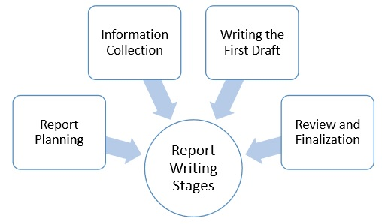

Slide 6


Major components of a general report
Title Page
Abstract/Executive Summary
Table of Content
Introduction
Main Body
Conclusion
Recommendations
References
Appendices

Slide 7
The abstract
An overview of the entire text.
(what was the problem, how was it investigated, what did you find out and what do your findings mean)
A short, half to one-page summary (Less than 200 words)
Usually written impersonally.
Has at least one sentence about each section of the report, in the same order.
Should be written after the report is completed and placed on the first page of the report.
The executive summary
May consist of several pages for a long report, and may include headings and dot points or numbered points.
Must be concise and without fine detail, providing a commentary on the main points only and following the sequence of the report itself.
Like the abstract, it should be written after the report is completed, when you have an overview of the whole text, and placed on the first page of the report.

Slide 8
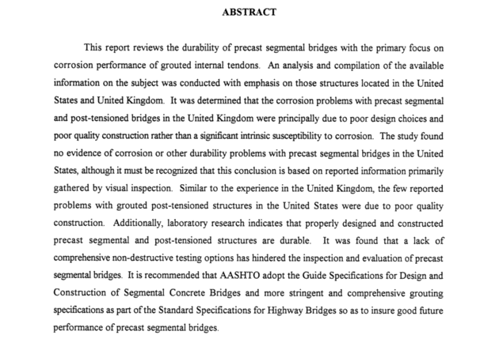

Slide 9
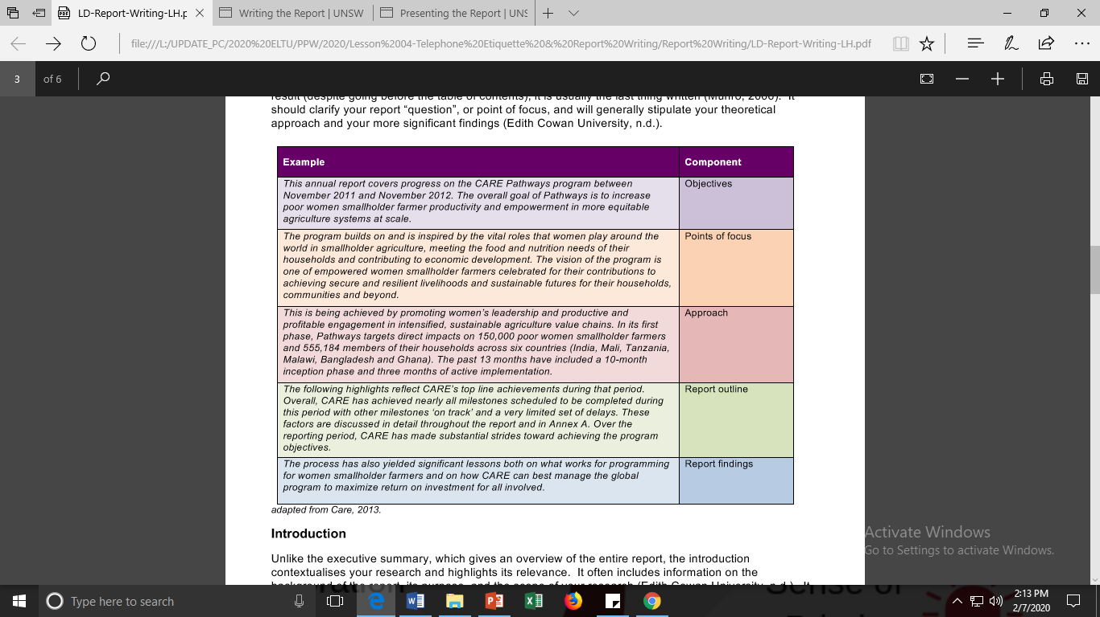
SAMPLE EXECUTIVE SUMMARY

Slide 10
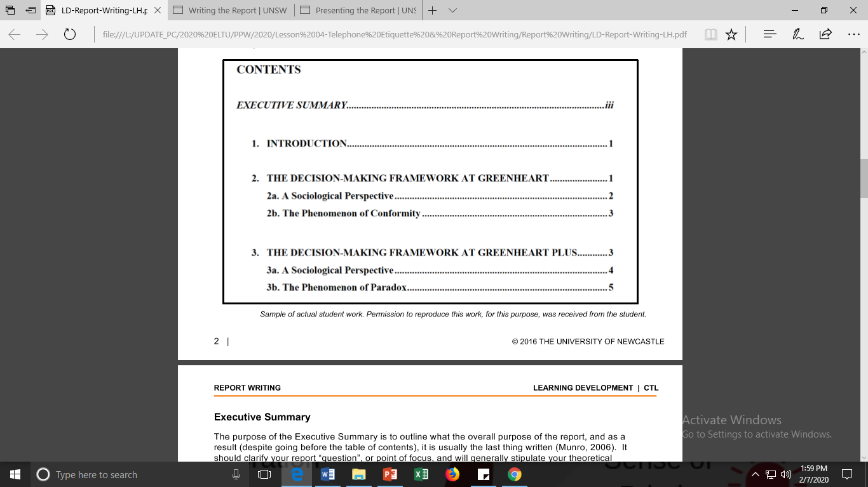
Table of Content
A list of the major and minor sections of your report.

Slide 11
Introduction
Give some background information about the topic.
State the aim/purpose of the investigation.
Outline the body sections.

Slide 12
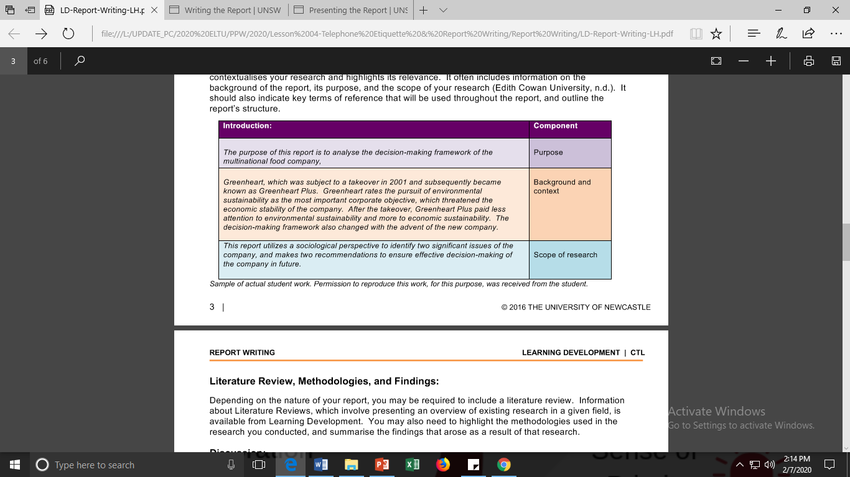

Slide 13
Main Body
Organise the sections in a logical sequence:
what you investigated
what you found
what interpretations and what judgments you made.
*Use short informative headings and subheadings.

Slide 14
Conclusion
What has been achieved
What is the significance of your findings and your discussion?
Have your aims been successful or not?

Slide 15
Recommendations
What do you recommend as a course of action following your conclusion?

Slide 16
References & Appendices
A list of all the sources you used.
Any information (graphs, charts, tables or other data) you used in your report but did not include in the body.

Slide 17
Recheck the report and see whether it has…
fulfilled the requirements
what the audience wanted or required
only the important/ relevant information

Slide 18
REFERENCES
https://www.uts.edu.au/current-students/support/helps/self-help-resources/academic-writing/abstract-and-executive-summary

